Slide 1
Simple Machines

Slide 2
Basic mechanisms
Simple machines that use mechanical principles to make work easier
By multiplying force or motion, changing direction, or transferring power
Essential components in engineering and everyday life.

Slide 3
A little bit about mechanical advantage
Work done = Force applied * Distance moved

Slide 4
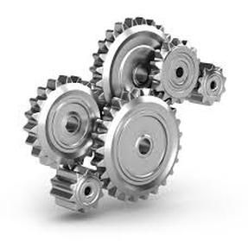
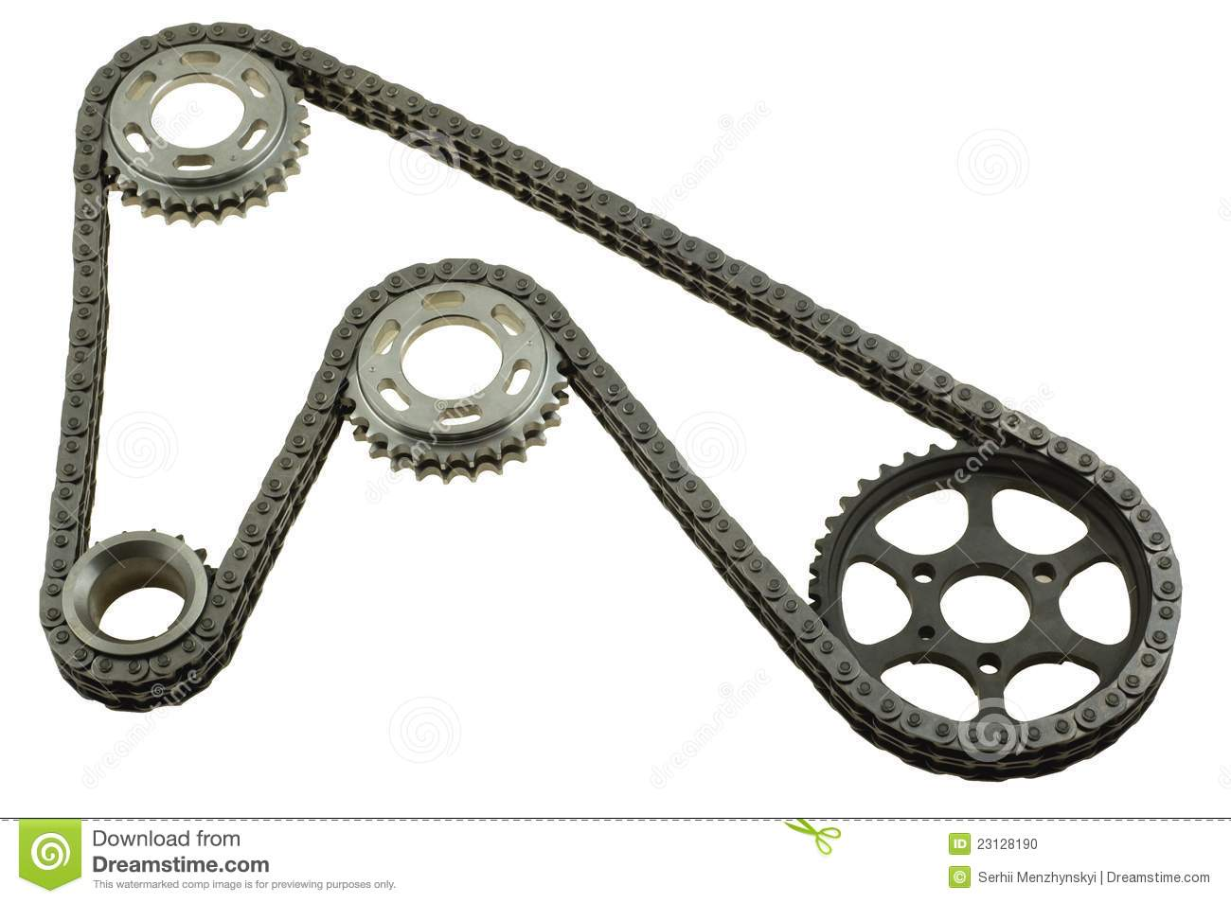
Gears & Chain drives
Gears and chain drives are basic mechanisms used to transmit motion and power between rotating shafts. They provide several mechanical advantages, including:
Speed and torque ratio
Smooth operation
Increased power transfer
Compact size
Notes:
Provides a mechanical advantage by increasing or decreasing the speed or torque of the input shaft to the output shaft.
Provide smooth and efficient operation, ensuring that the machinery runs smoothly and effectively.
Can transfer more power than other types of mechanisms, making them ideal for high torque applications.
Can be designed to be very compact, allowing them to be used in applications where space is limited.

Slide 5
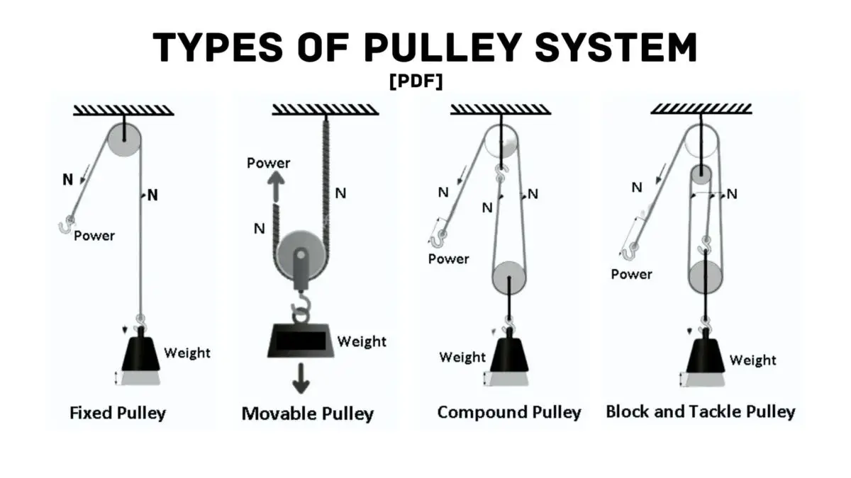
Pulleys
Pulleys are basic mechanisms that consist of a wheel with a grooved rim and a rope or cable that fits into the groove. They provide several mechanical advantages, including:
Force reduction
Directional change
Speed reduction
Power transmission
Notes:
Can reduce the amount of force needed to lift a heavy object, enabling users to lift loads more easily.
Can be used to change the direction of a force, allowing a person to lift a load from a lower position to a higher position or move an object horizontally.
Can be used to reduce the speed of a rotating shaft, which can be useful in applications where speed needs to be controlled or reduced.
Can transmit power and motion from one rotating shaft to another, which is useful in many mechanical systems.
Fixed pulleys: Changes the direction of force without providing mechanical advantage.
Movable pulleys: Provides mechanical advantage by reducing the force needed to lift the load.
Compound pulleys: Consists of fixed and movable pulleys arranged to provide greater mechanical advantage than a single movable pulley.
Block and tackle: A system of multiple pulleys used to multiply mechanical advantage provided by a single pulley.

Slide 6
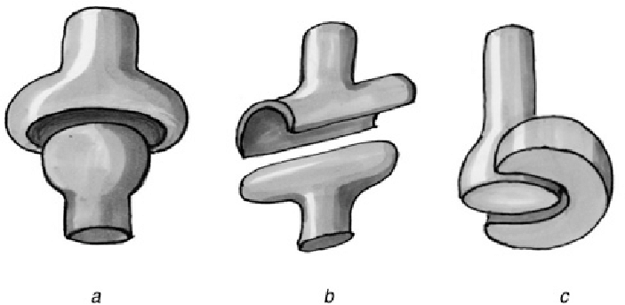
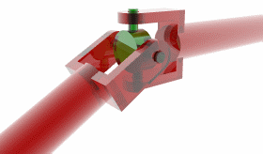
Joints & Couplings
Couplings are mechanical devices that are used to connect two shafts together to transmit power and motion. Some basic joints & couplings:
Notes:
There are various types of couplings available, including rigid couplings, flexible couplings, and fluid couplings. Each type of coupling is designed to meet specific requirements, such as compensating for misalignment or dampening shock and vibration.
Typically made from materials such as steel, aluminum, or nylon, depending on the application and the specific requirements of the machinery.
Proper installation and maintenance of couplings are important for ensuring their longevity and effectiveness. This includes ensuring proper alignment of the shafts and periodically checking for wear and tear on the coupling components.
The selection of the appropriate coupling size is important for ensuring that the coupling can transmit the necessary amount of power and torque without failure or damage.

Slide 7
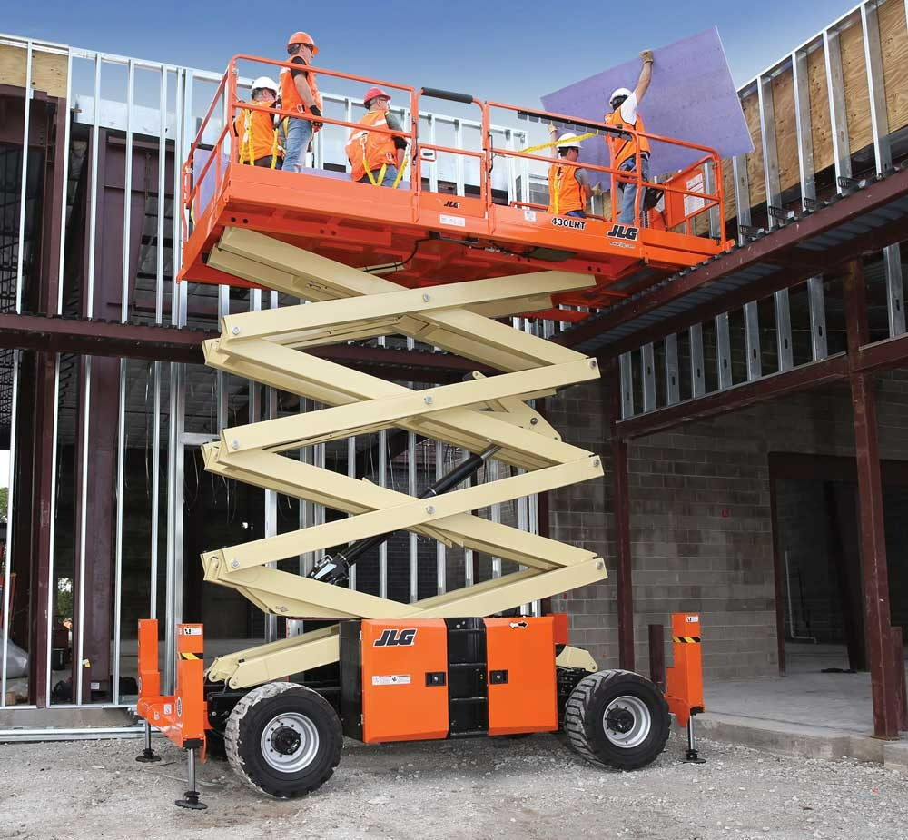
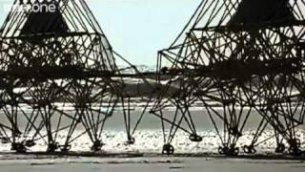
Linkages
Linkages are basic mechanisms that are made up of a series of rigid bodies or links connected by joints.
Notes:
There are various types of linkages available, including simple linkages, complex linkages, and parallel linkages, each designed to meet specific mechanical requirements.
Linkages are used in a wide range of applications, including steering systems, suspension systems, and robotic arms.
Linkages are typically constructed from rigid components such as rods, bars, or plates that are joined together with pivots or hinges.
Linkages can be designed to move in a variety of ways, including linear motion, rotational motion, or a combination of both.

